Slide 1

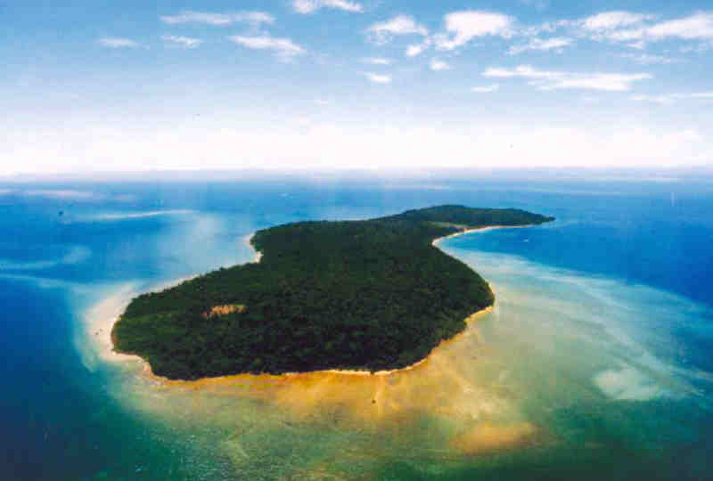
Island Survivor
Basic 5 Communication

Slide 2
Island´s information
It´s in the Pacific Ocean.
In the afternoon, it is very hot – 100 decrees F / 38 degrees C
There is very little drinking wáter on the island
There are some fruit trees on the island.

Slide 3
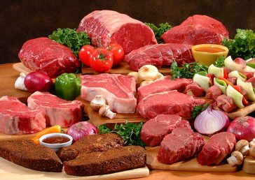
Meat

Slide 4
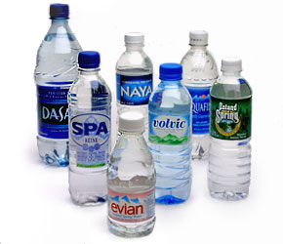
Bottled water

Slide 5
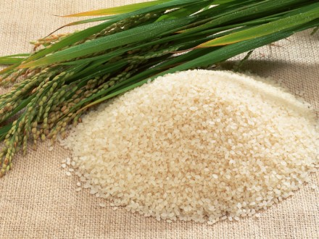
rice

Slide 6
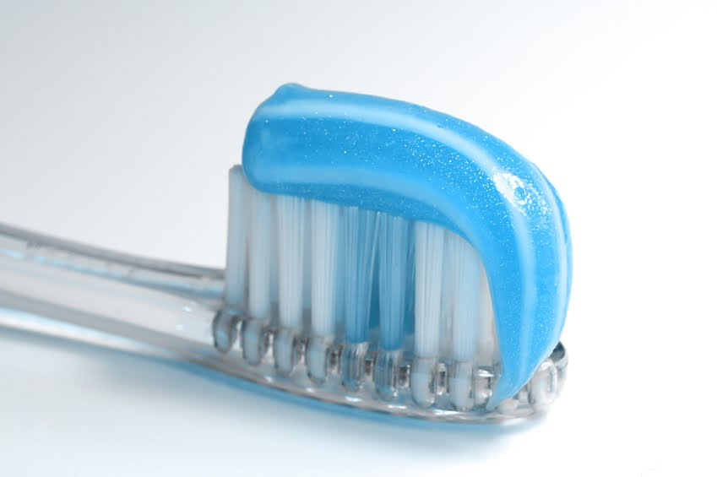
toothpaste

Slide 7
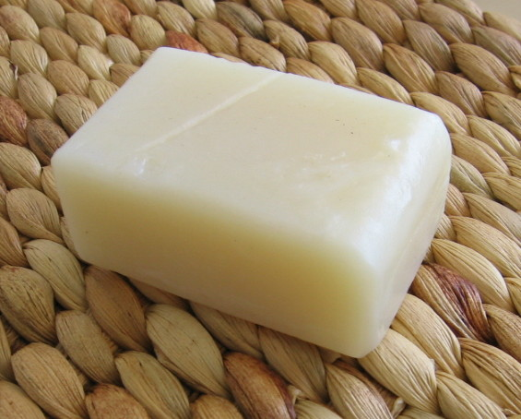
Soap

Slide 8
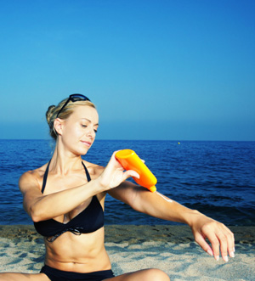
sunscreen

Slide 9
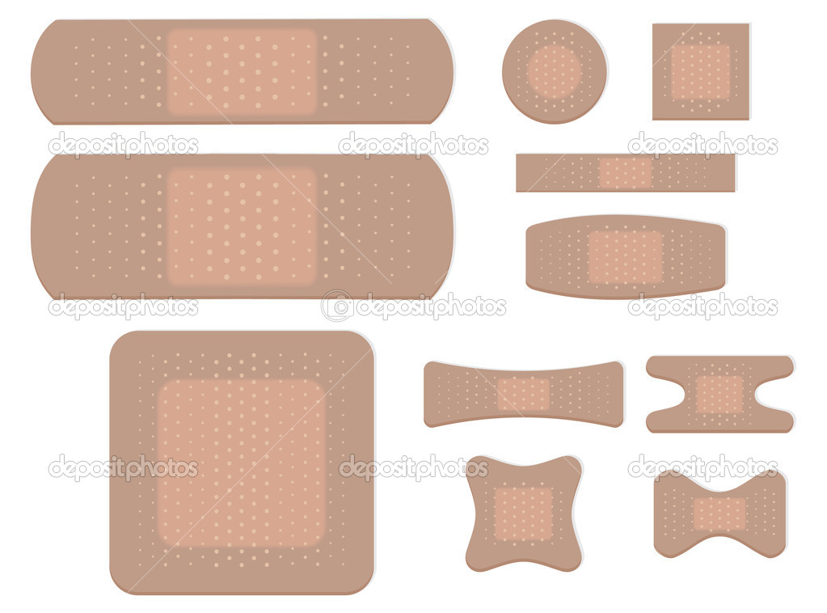
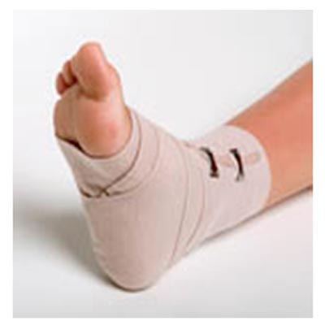
Bandages

Slide 10
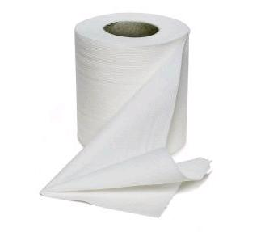
Toilet paper

Slide 11
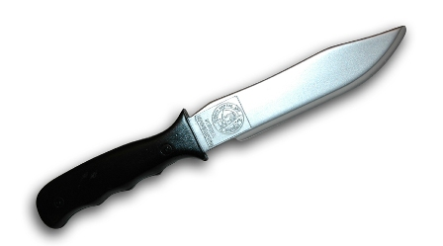
Knife

Slide 12
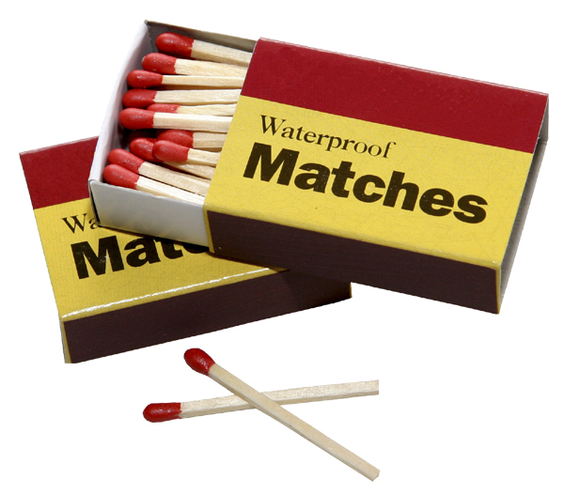
matches

